Slide 1


Learning Shape-to-Shape Transformation
Kangxue Yin
PhD Thesis Defense
9:30 a.m. - May 14th, 2020
Examining Committee: Dr. Hao (Richard) Zhang, Senior Supervisor; Dr. Hui Huang, Supervisor; Dr. Daniel Cohen-Or, Supervisor; Dr. Manolis Savva, Internal Examiner; Dr. Matthias Zwicker, External Examiner; Dr. Angel Chang, Chair.
Notes:
Good morning everyone, and good evening to the committee members joining the defense remotely from the other side of the earth.
Today I’ll summarize the work I have done during my PhD program on “Learning shape-to-shape transformation”

Slide 2
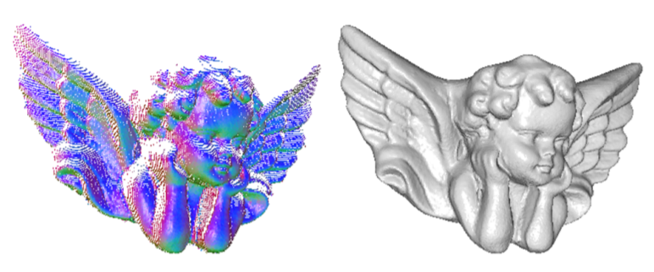
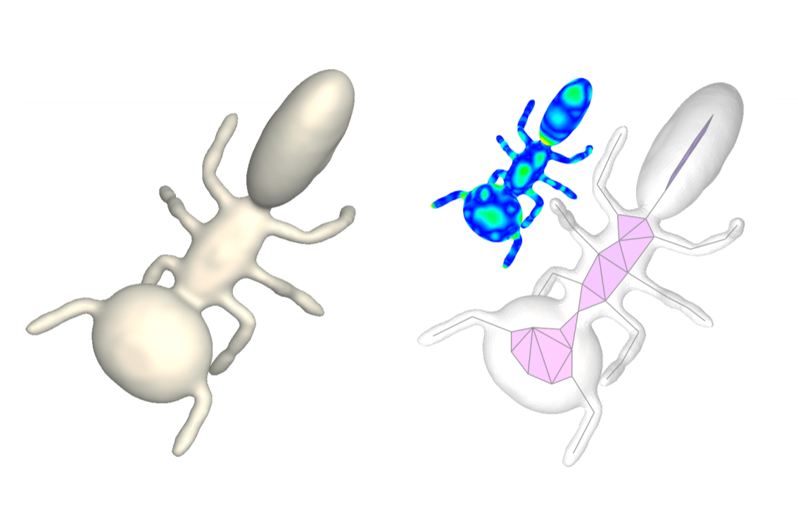
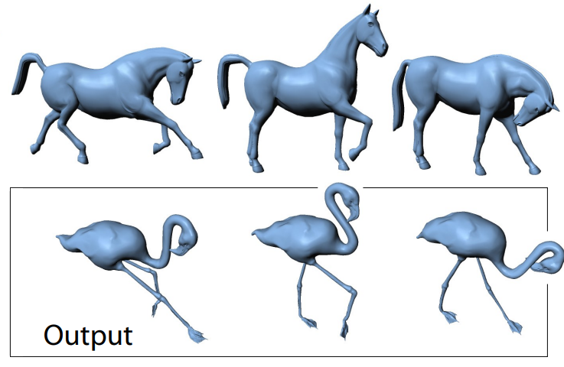
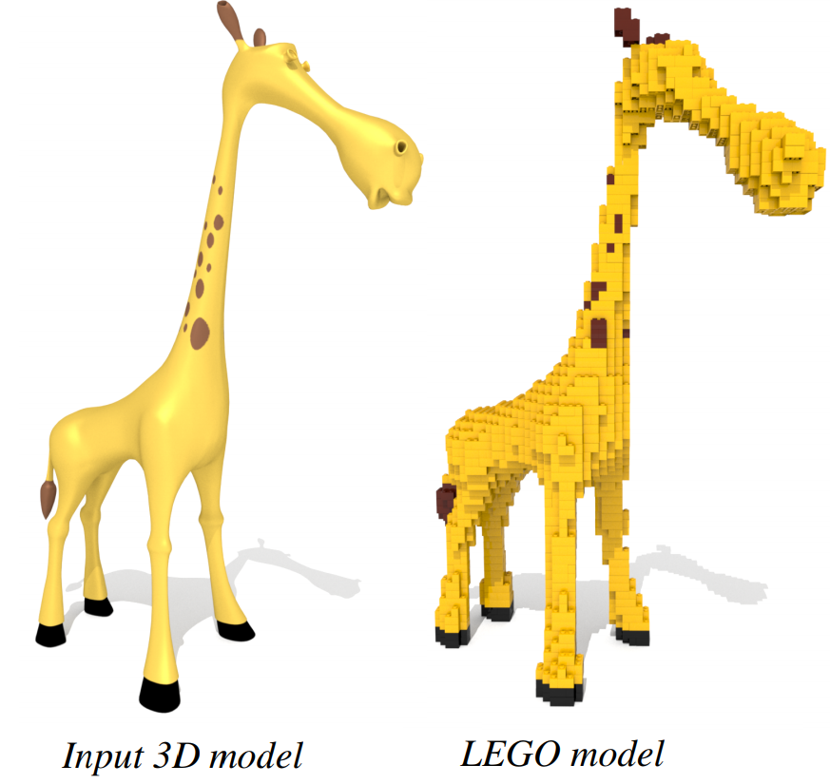
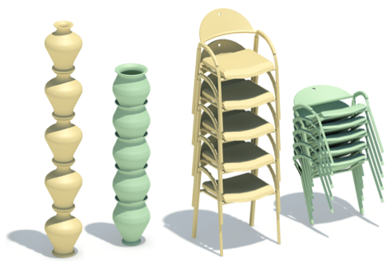
Shape transform in geometric modeling
Surface completion [Kazhdan et al. 2013]
Skeletonization [Li et al. 2015]
Stackabilization [Li et al. 2012]
Deformation transfer [Sumner et al. 2004]
Stylization [Luo et al. 2015]
Notes:
Many problem in computer graphics can be posed as a problem of shape-to-shape transformation
For example, surface completion can be considered as..
Shape skeletonization is …
Stackabilization is a problem of transforming non-stackable shapes into stackable shapes

Slide 3
General-purpose shape-to-shape transformation?
Notes:
With so many problems in computer graphics can be considered as a problem of shape-to-shape transformation.
It is then natural to ask, can we develop general purpose methods for solving many of these problems?

Slide 4


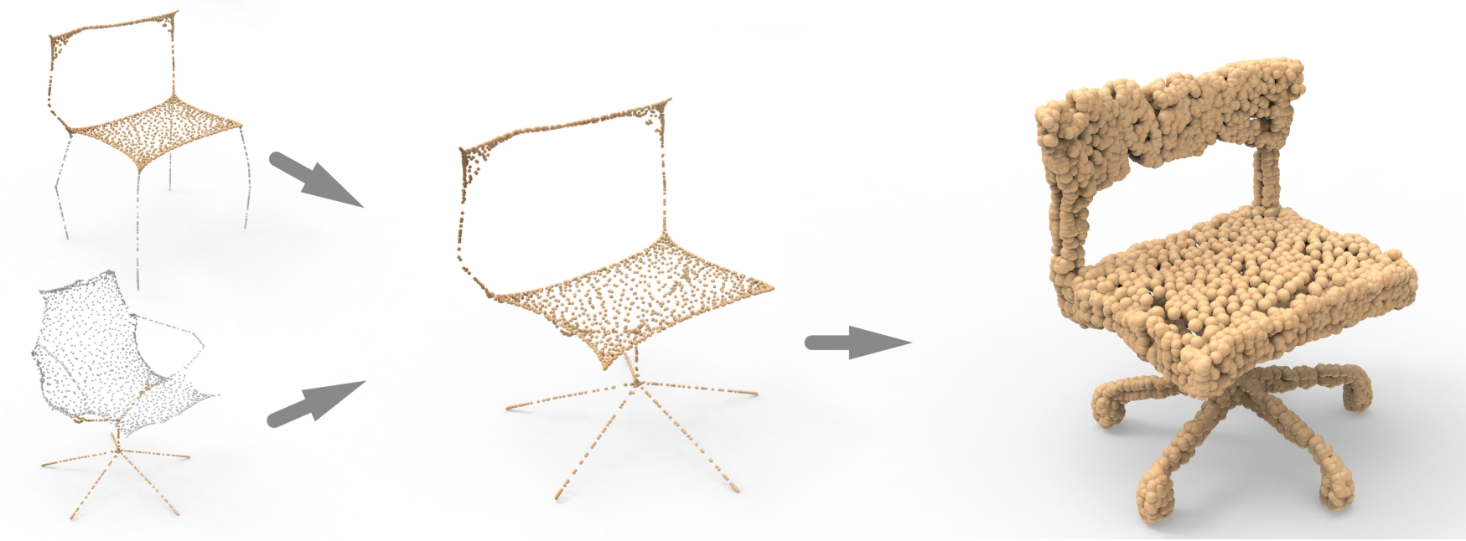
General-purpose methods?
Find common characteristics among different problems. Better understand and solve these problems.
New problems and new applications.
Notes:
With a general-purpose method, we can…
It will also enable new problems and new applications. Let me show you an example. In P2P-NET, we …

Slide 5

General-purpose methods?
Find common characteristics among different problems. Better understand and solve these problems.
New problems and new applications.
Technology reuse: avoid re-inventing the wheel
Notes:
Reuse technologies and avoid reinventing the wheel
Help the community progress faster

Slide 6
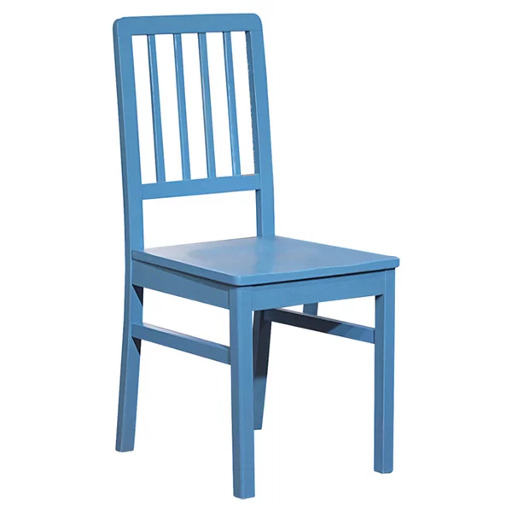
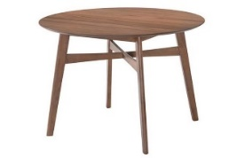
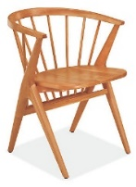
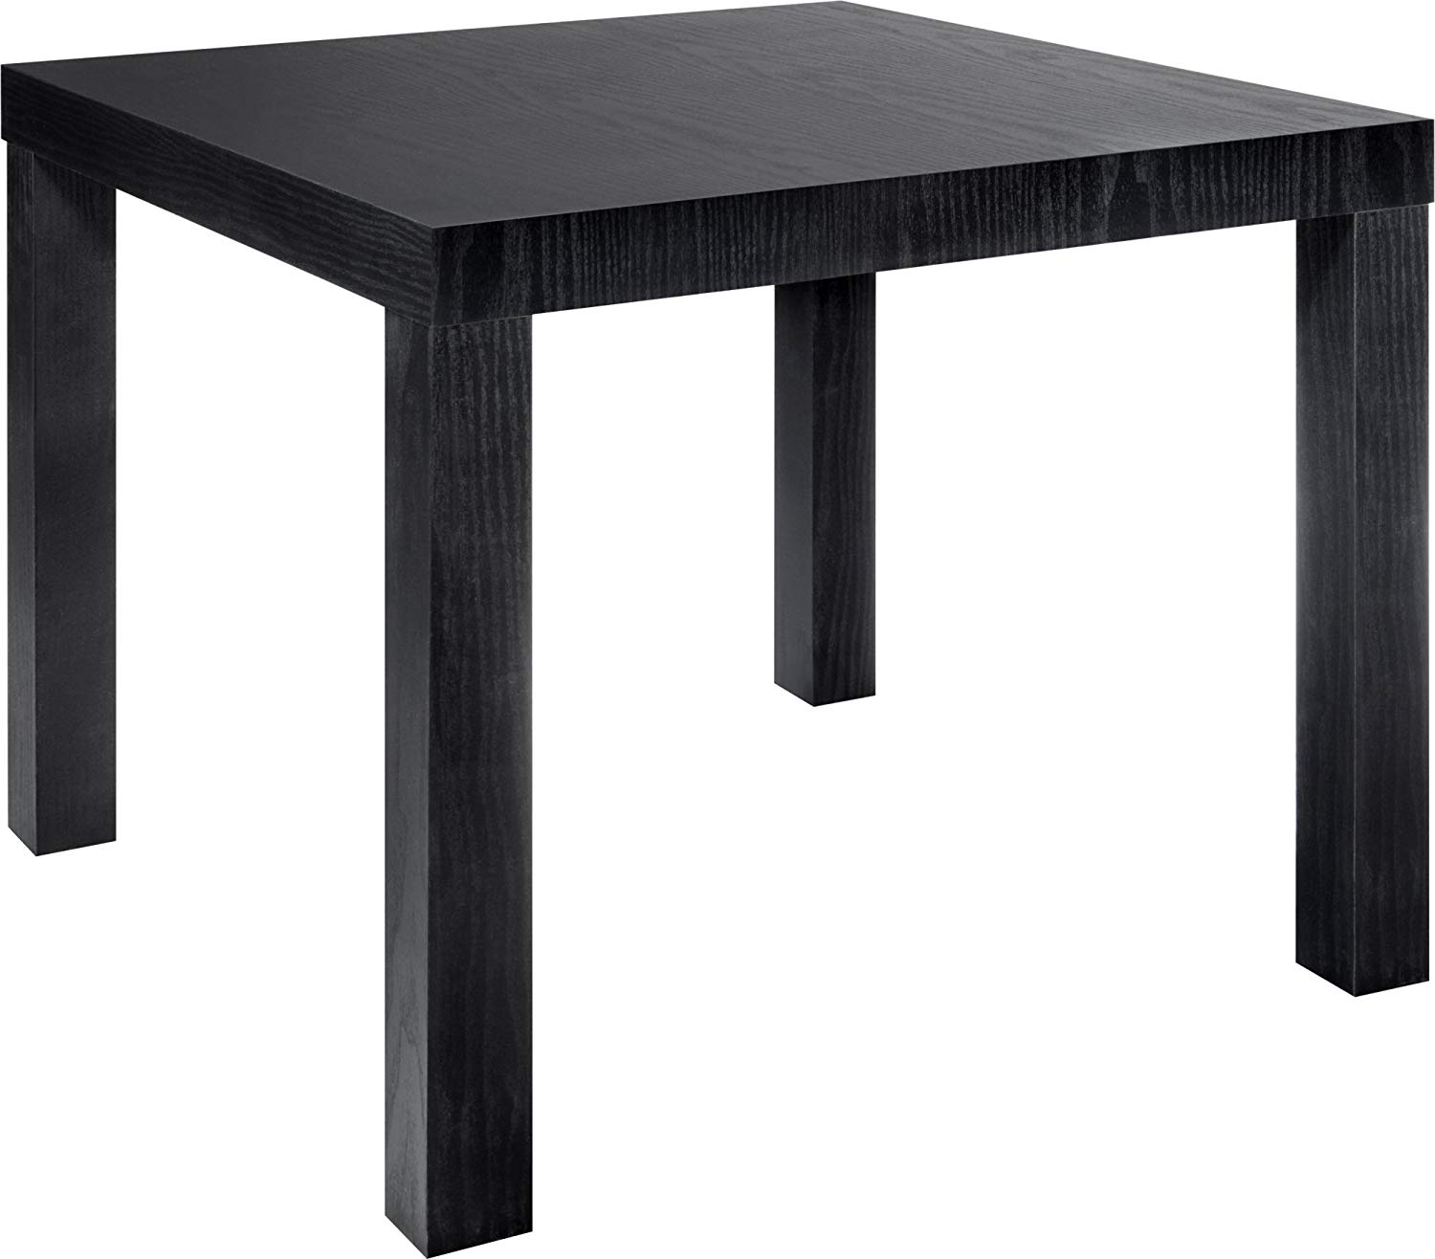
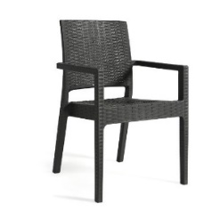
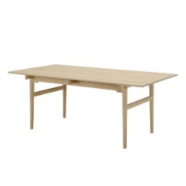
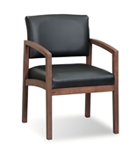
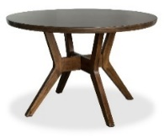
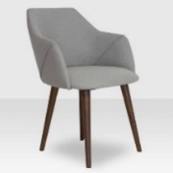
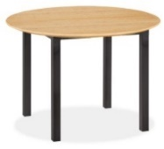
Learning general-purpose shape transform
Problem definition
Domain A
Domain B
Notes:
OK. Let’s define the problem.
To learn gp shape transform, we need two set of training shapes.
One set is from domain A.
Another set is from …
Our network will be trained by the two set of shapes.

Slide 7
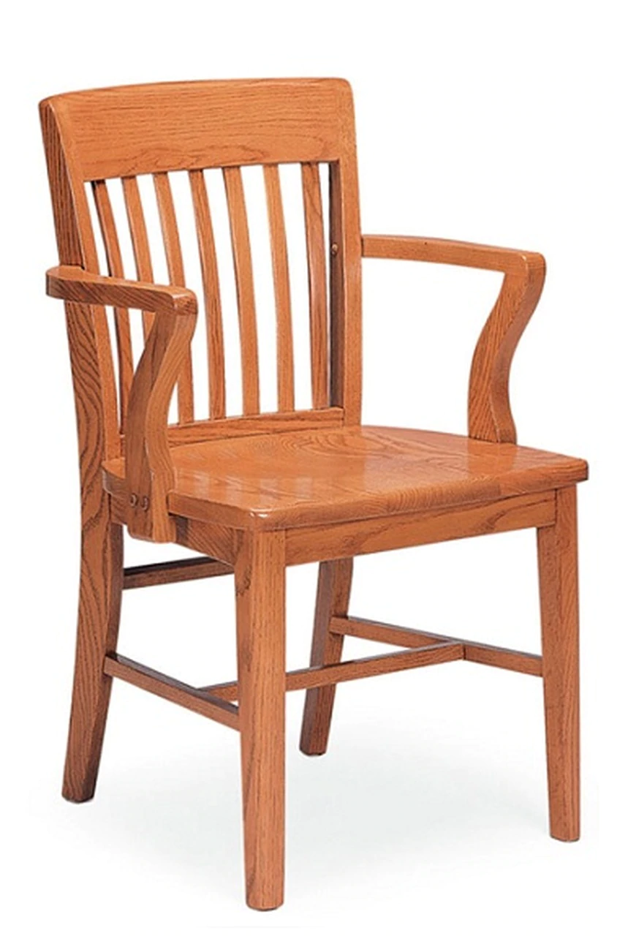
Learning general-purpose shape transform
Problem definition
?
Belong to domain B
Commonality
Domain A
Domain B
Notes:
During test, we provide an input shape from domain A, and ask the network to
But we do not want a random table, we want the output table to have some commonality with the input chair.

Slide 8
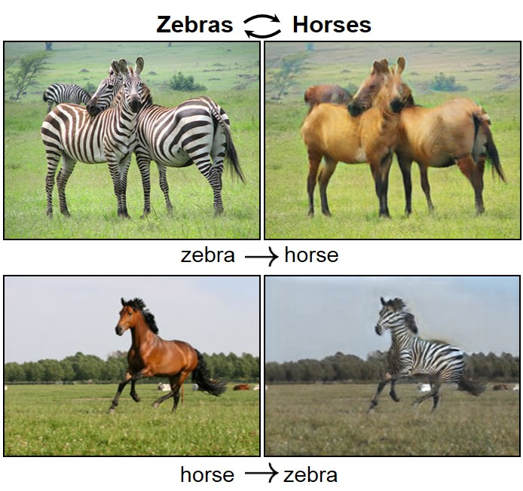
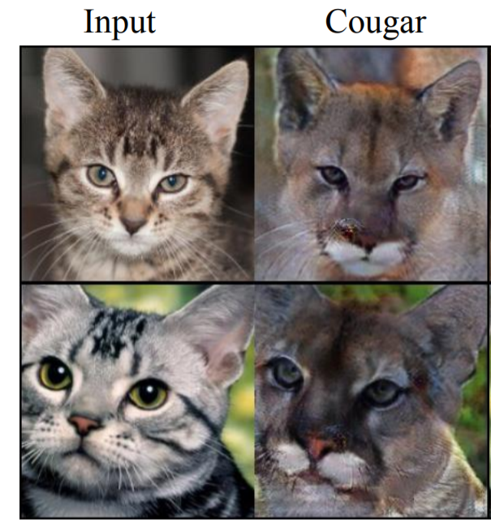
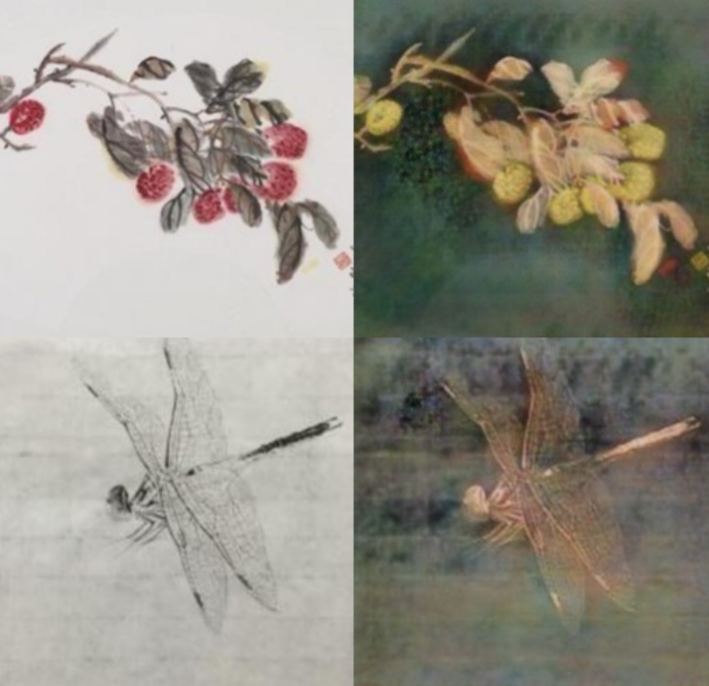
Background
Image-to-image translation
Chinese painting Oil painting
DualGAN [Yi et at. 2017]
CycleGAN [Zhu et at. 2017]
UNIT [Liu et at. 2017]
Notes:
A similar problem in computer vision is learning gp I2I translation.
Here I just show 3 representative methods.
In DualGAN and CycleGAN, they train two directions of image translation simultaneously. And they have a cycle consistency or a dual learning loss to encourage the …
In unit, a shared latent space is learned. Image trans is then done by first encoding the image into the shared latent space, then...
However, these methods are mainly designed for transferring textures or colors. They cannot work on shape transform.

Slide 9
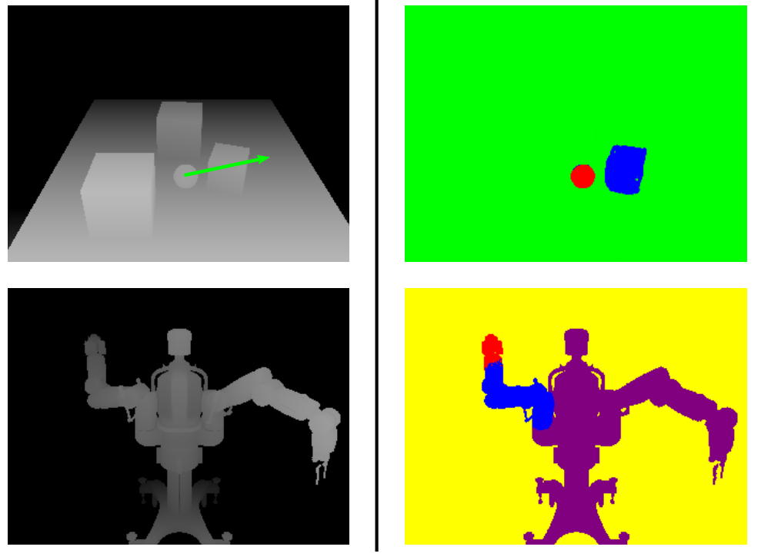
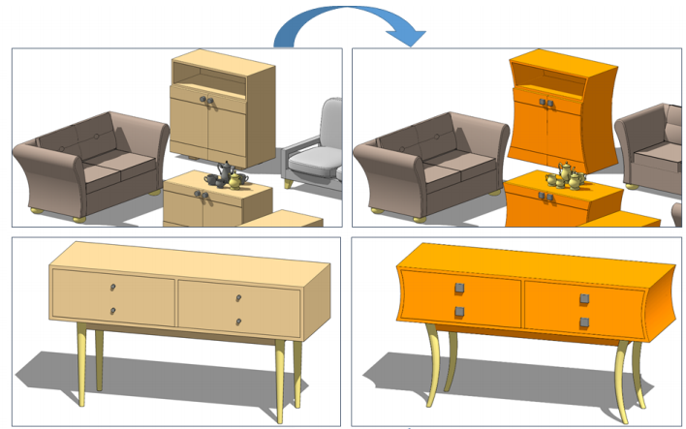
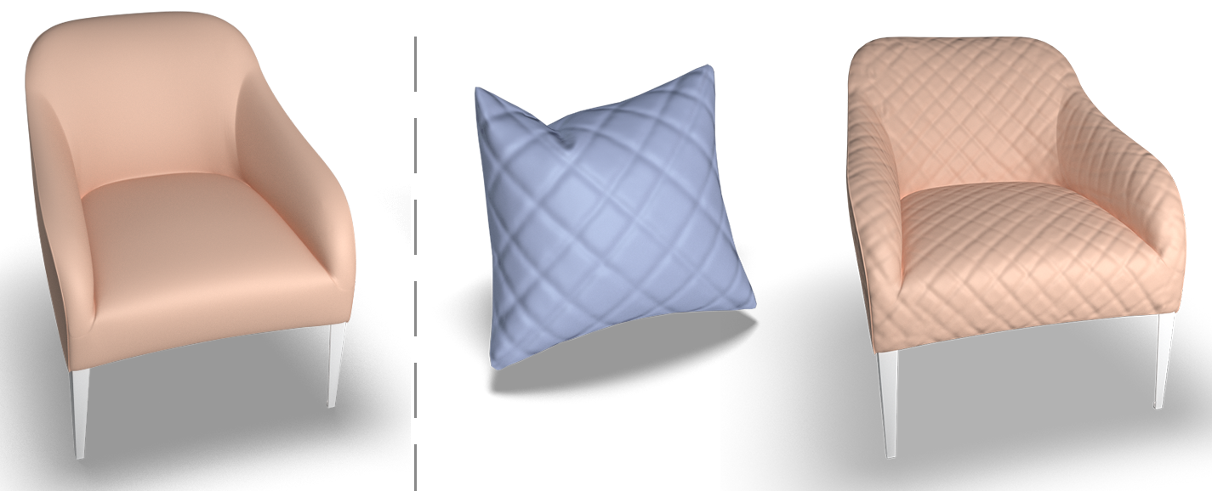
Background
Learning shape transform
Surface detail transfer
[Berkiten et al. 2017]
Rigid body motion
[Byravan et al. 2017]
Shape style transfer
[ Lun et al. 2016]
Notes:
There do exist some methods for learning shape transforms.
For example, Berkiten et al. [at L].
Byravan et al.
However, these methods are only able to learn a specific type of shape-to-shape transformation. They are not general purpose.

Slide 10
Contributions
Proposed the first general-purpose shape-to-shape translation networks
P2P-NET: Supervised
LOGAN: Unsupervised
Novel technical contributions that make the networks work
Displacements based representation for shape transformation, and cross regularization (in P2P-NET)
Implicit feature disentanglement (in LOGAN)
etc.
Open the door to new research topics in geometric deep learning
Future works
Notes:
In this thesis, we propose… P2P-NET is the first supervised… LOGAN is the first unsupervised…
This is our main contribution
Furthermore, we have…
The research also opens door to new …

Slide 11
Challenges of the problem
Lack of point-to-point correspondences
Representation of shape transform
Feature disentanglement
Chinese painting Oil painting
DualGAN [Yi et at. 2017]
CycleGAN [Zhu et at. 2017]
UNIT [Liu et at. 2017]
Notes:
We experienced some challenges whole solving the problem of GP shape2shape transformation.
The 1st challenge is lack of …
In image2image trans, they actually have pixel2pixel correspondence which is implied by the pixel coordinates.
But in shape transform, we do not have p2p correspondence

Slide 12
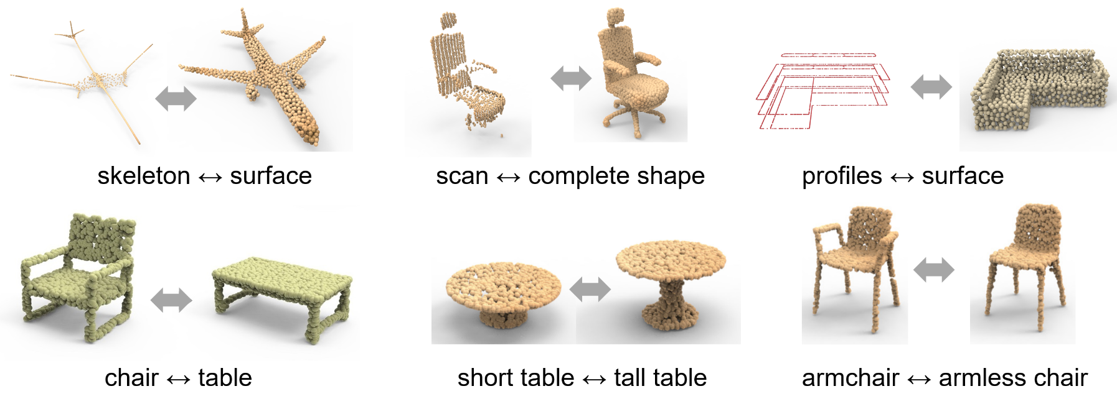
Challenges of the problem
Lack of point-to-point correspondences
Representation of shape transform
Feature disentanglement
Notes:
The second challenge is the representation of shape transform.
Here I show 6 example type of shape transforms learned by our network, as you can see that they are very different from each other. It is then challangeing to design a generic represention for..

Slide 13
Challenges of the problem
Lack of point-to-point correspondences
Representation of shape transform
Feature disentanglement
?
commonality
Domain A
Domain B
Notes:
The 3rd chanllege is … As I just mentioned, we do not want a random…
Disentangle common features from domain-unique features

Slide 14
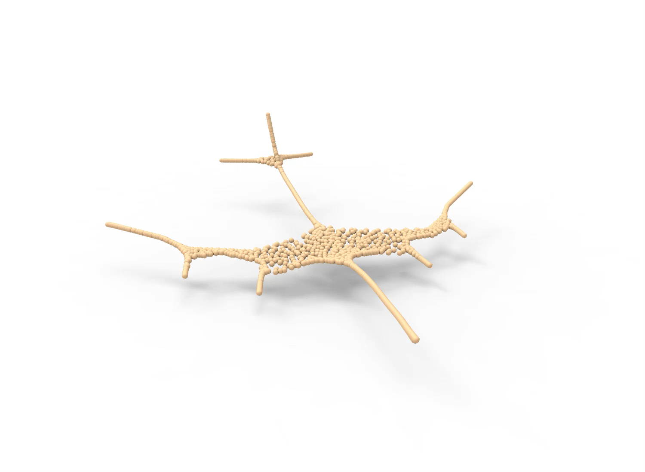
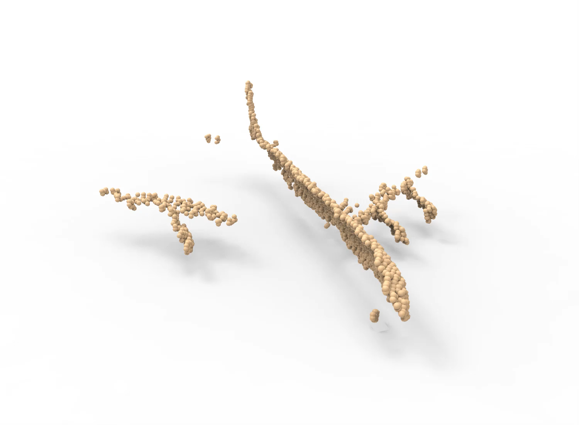
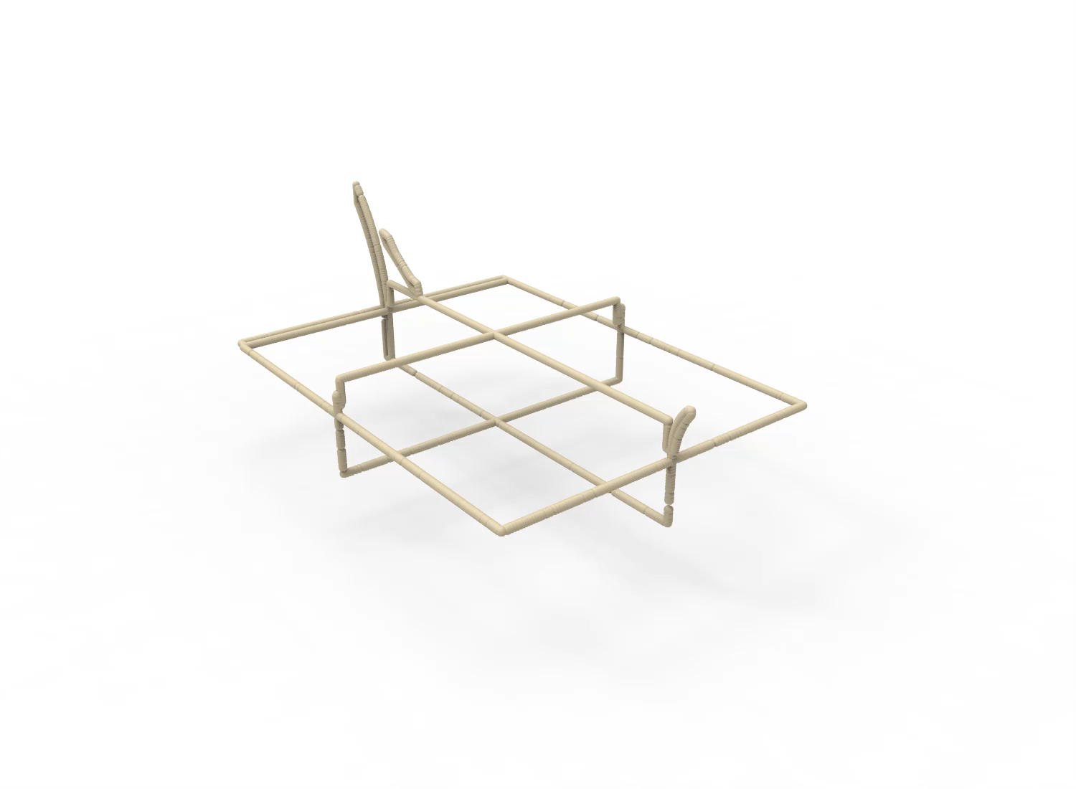
Overview
Shape-level supervision
Unsupervised
P2P-NET: Point-to-point displacement network

Slide 15
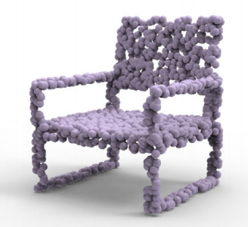
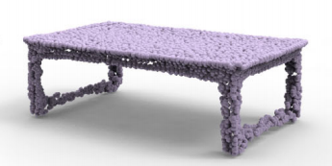
Overview
Shape-level supervision
Unsupervised
Feature disentanglement
Latent space
LOGAN: Unpaired Shape Transform in Latent Overcomplete Space

Slide 16
P2P-NET: Point-to-point displacement network
Chapter. 3

Slide 17
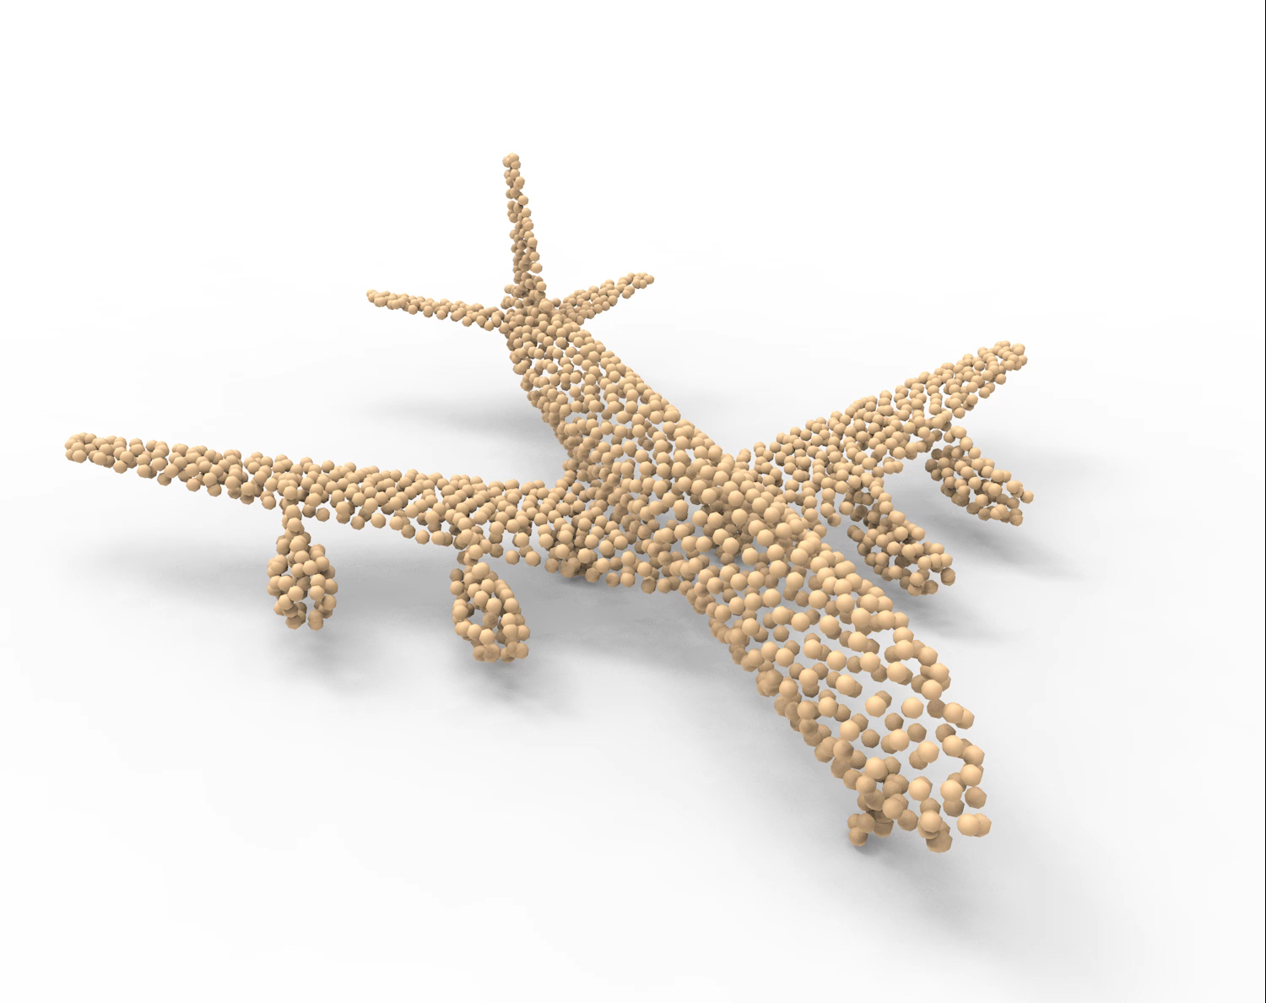
Point-to-point displacements
P2P-NET

Slide 18
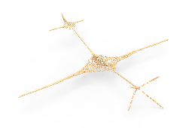
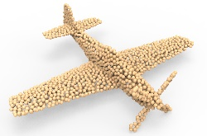
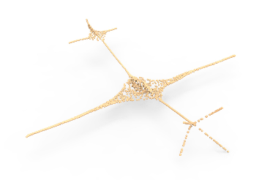

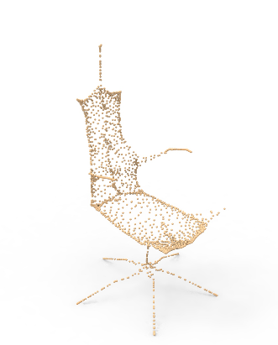
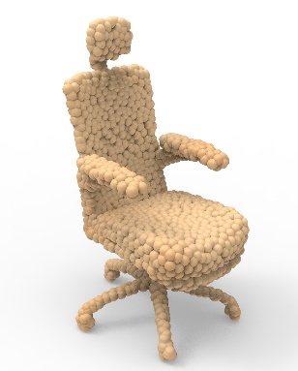
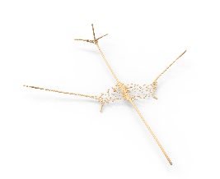
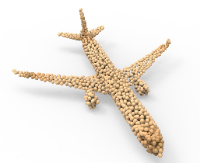
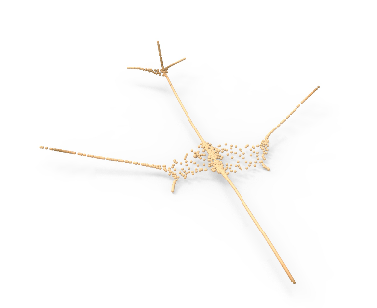

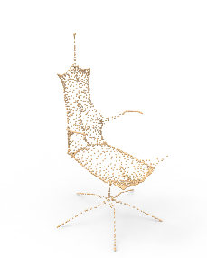

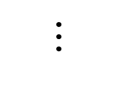
Paired shapes from two domains
...
...
$$⋯$$
Domain A
Domain B
Paired shapes
Without point-to-point correspondence

Slide 19
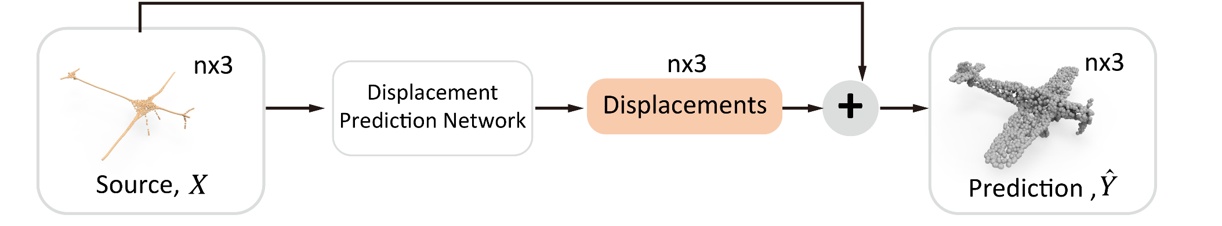
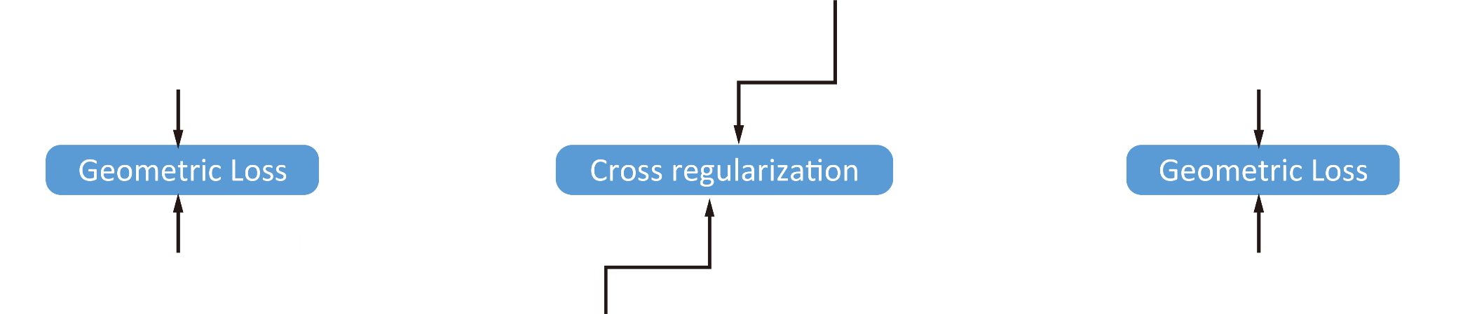
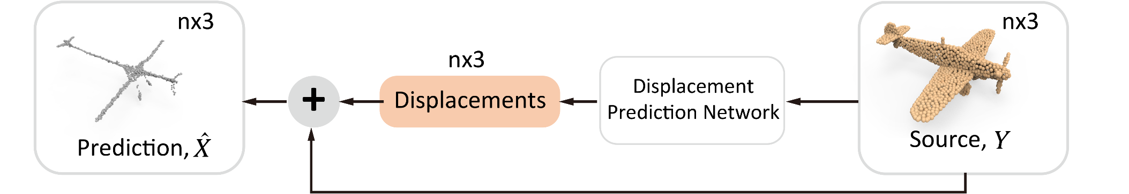
Bidirectional P2P-NET

Slide 20
Single branch

Slide 21
Loss = Geometric Loss + Cross Regularization

Slide 22
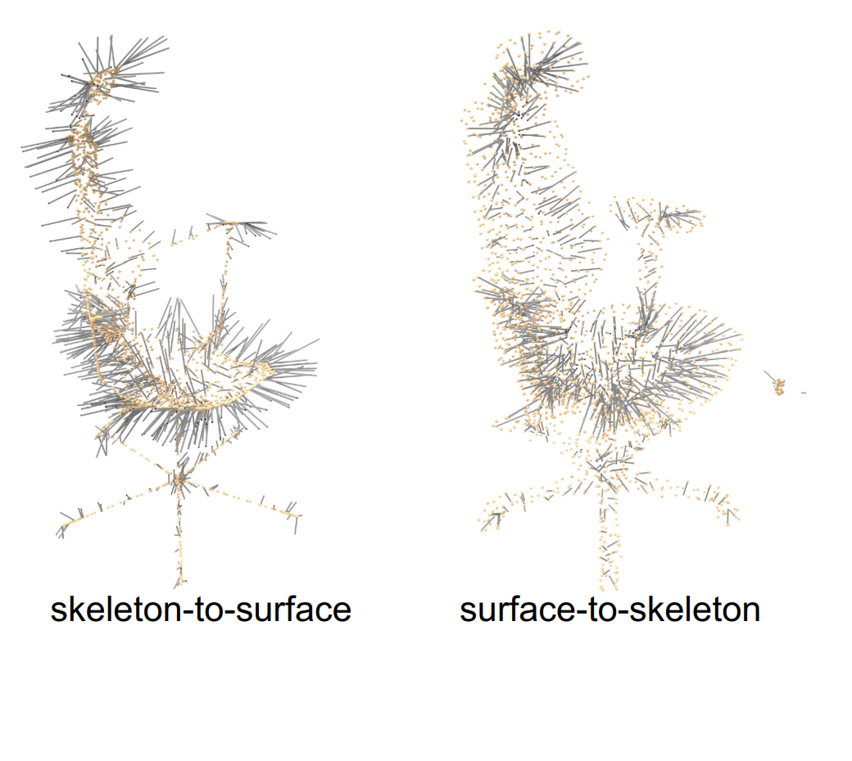
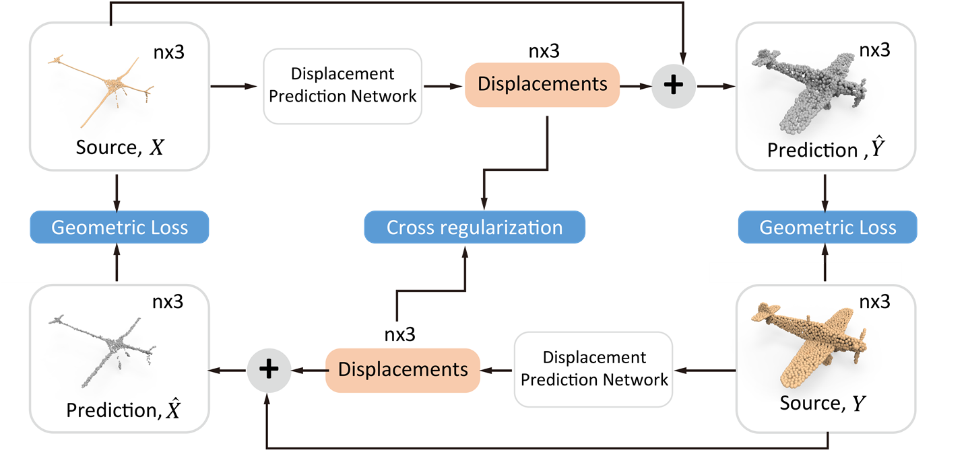
Loss = Geometric Loss + Cross Regularization
Parallel ?

Slide 23
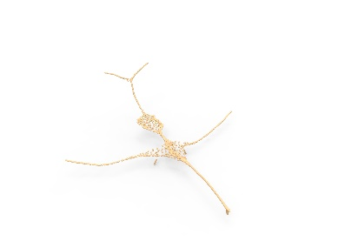
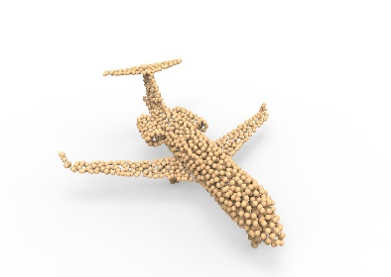
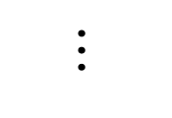
Results and experiments
Training
Same architecture
Same hyperparameters
without post-processing
$$⋯$$
Meso-skeleton ↔ surface

Slide 24
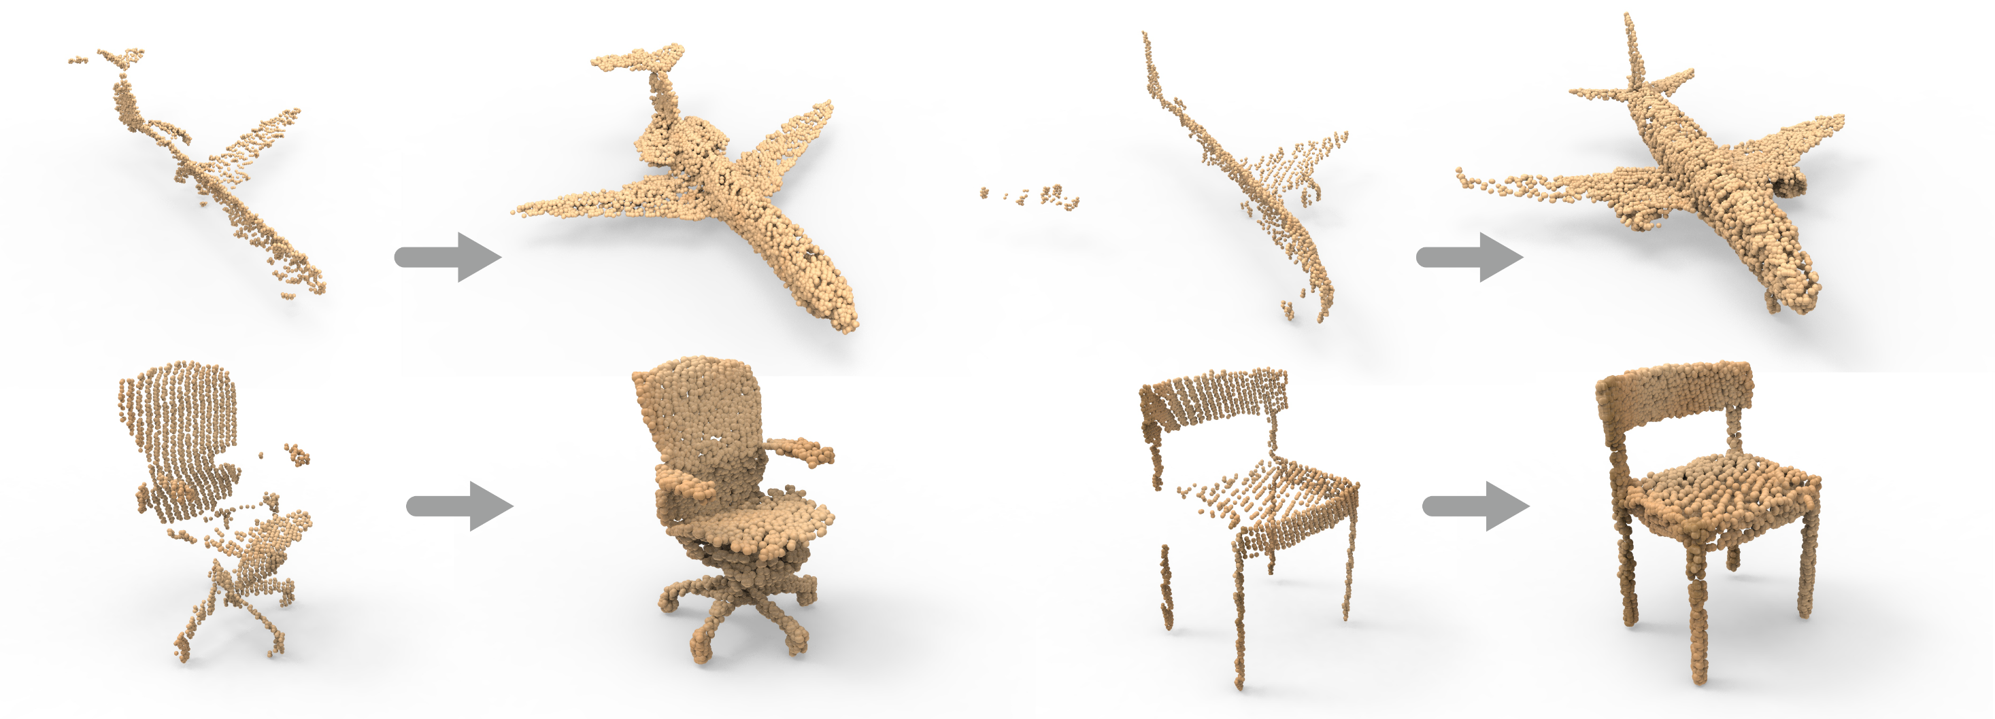
Incomplete scan → complete surface
Incomplete scan
Complete surface
Incomplete scan
Complete surface

Slide 25
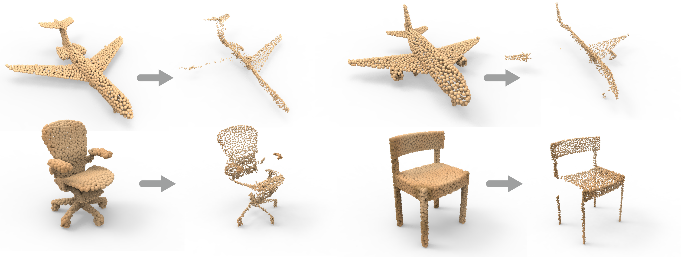
Complete surface → incomplete scan
Complete surface
Incomplete scan
Complete surface
Incomplete scan
Notes:
Useful for automous driving

Slide 26

Surface samples → meso-skeleton
Surface samples
Meso-skeleton
Surface samples
Meso-skeleton

Slide 27

Meso-skeleton → surface samples
Meso-skeleton
Surface sample
Meso-skeleton
Surface sample

Slide 28
Application: shape editing

Slide 29

Cross-section profiles & surface samples

Slide 30
LOGAN: Unpaired Shape Transform in Latent Overcomplete Space
Chapter. 4

Slide 31







Unsupervised shape transform
LOGAN
Domain A
Domain B
LOGAN = Latent Overcomplete GAN

Slide 32
Unsupervised shape transform
Implicit feature Disentanglement
Overcomplete Latent Space
LOGAN: Unpaired Shape Transform in Latent Overcomplete Space

Slide 33

LOGAN Component 1. Overcomplete Autoencoder

Slide 34

LOGAN Component 2. Translator

Slide 35
LOGAN Component 2. Translator

Slide 36
LOGAN Component 2. Translator
Two loss terms compete!

Slide 37

Ablation study of translation loss terms
Input
WGAN + Cycle
WGAN + FP
WGAN + FP + Cycle

Slide 38

Ablation study and comparison to baselines

Slide 39


Result: Table ↔ Chair
input chair output table
input table output chair

Slide 40

Result: Tall Table ↔ Short Tale
Short Tall
Tall Short

Slide 41




Either content transfer or style transfer…
M → N
N → M
wide → narrow
narrow → wide

Slide 42

LOGAN vs. image translation networks

Slide 43
Chapter. 5
Conclusion and Future Work
Notes:
To conclude, in this thesis we proposed

Slide 44
Conclusion
General-purpose deep neural networks for learning shape-to-shape transformation
P2P-NET, LOGAN

Slide 45

Conclusion
General-purpose deep neural networks for learning shape-to-shape transformation
P2P-NET, LOGAN
Interesting points:
Shape transformations learned by P2P-NET are represented by point displacements that do not exist in the training set.

Slide 46

Conclusion
General-purpose deep neural networks for learning shape-to-shape transformation
P2P-NET, LOGAN
Interesting points:
Shape transformations learned by P2P-NET are represented by point displacements that do not exist in the training set.
LOGAN can perform both content and style transfers between shapes.

Slide 47
Conclusion
General-purpose deep neural networks for learning shape-to-shape transformation
P2P-NET, LOGAN
Interesting points:
Shape transformations learned by P2P-NET are represented by point displacements that do not exist in the training set.
LOGAN can perform both content and style transfers between shapes.
Implicit feature disentanglement.

Slide 48
Conclusion
General-purpose deep neural networks for learning shape-to-shape transformation
P2P-NET, LOGAN
Interesting points:
Shape transformations learned by P2P-NET are represented by point displacements that do not exist in the training set.
LOGAN can perform both content and style transfers between shapes.
Implicit feature disentanglement.
New research topic for geometric deep learning

Slide 49


Future work
Transitive transformation
Domain A
Domain B
Notes:
['hjuːmən]

Slide 50

Future work
Transitive transformation
Domain A
Domain C
Domain B

Slide 51

Future work
Transitive transformation
Multi-modal transformation
Notes:
[mʌltɪ'mɒdl]

Slide 52
Future work
Transitive transformation
Multi-modal transformation
One-shot transformation
Single pair of shapes

Slide 53


Future work
Transitive transformation
Multi-modal transformation
One-shot transformation
Direct shape-to-shape transformation on meshes
Notes:
https://3dwarehouse.sketchup.com/model/7d92efda69ca6c25743c8e4ea4f6b92c/Bistro-table-set

Slide 54


Future work
Transitive transformation
Multi-modal transformation
One-shot transformation
Direct shape-to-shape transformation on meshes
Learning geometric deformation for image-to-image translation

Slide 55
Acknowledgments
My supervisors
Hao (Richard) Zhang, Hui Huang, Danny Cohen-Or
My family and friends
Examining committee
Thank you!

Slide 56


Questions?
Notes:
I am ready to take any questions

